Slide 1



BINDU: Deadlock-Freedom with One Bubble in the Network
http://synergy.ece.gatech.edu
Mayank Parasar, and Tushar Krishna
School of Electrical and Computer Engineering
Georgia Institute of Technology
mparasar3@gatech.edu
tushar@ece.gatech.edu

Slide 2
Many-Core → Networks-on-Chip

Slide 3
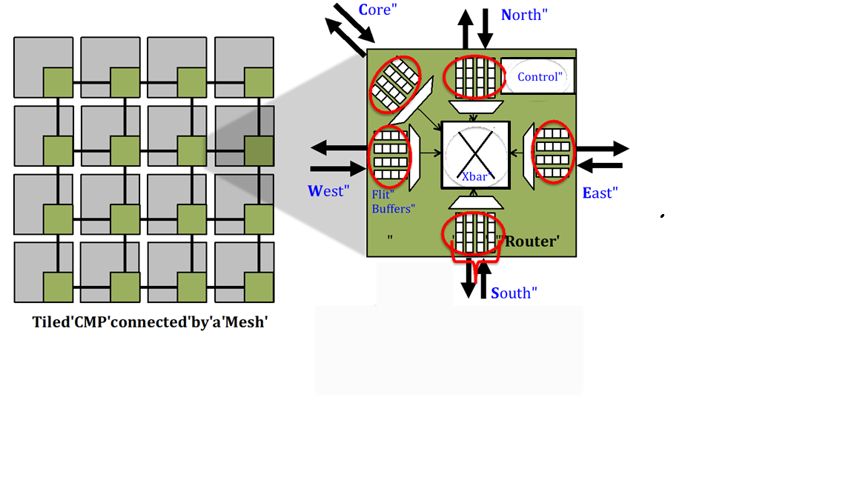
Router Micro-Arch
Core
North
Control
West
Xbar
East
Buffers
Router
South
Router micro-architecture

Slide 4
Challenge: Routing Deadlock
Network
6
9
10
5
Network
Deadlock
Network
5
6
10
9
Destination Router-5
Network
5

Slide 5
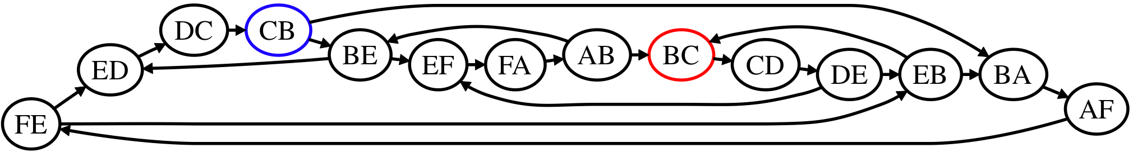
Channel Dependency Graph (CDG)
F
D
E
Cycle
A
C
B
Function of both Topology and Routing Algorithm
Deadlock occurs because of cycles present in the channel dependency graph of the topology

Slide 6
What is a deadlock?
Renders the forward progress of packets impossible
Correctness problem, can cause complete system failure.
Caused due to cycles in Channel Dependency Graph (CDG)

Slide 7
Outline
Background: Deadlocks
Current Solutions
BINDU
Concept
Definition
Walk-through
Deadlock freedom proof
Router microarch
Evaluations
Methodology
Results
Conclusion

Slide 8
Prior Work
Dally’s theory
Strict order in acquisition of links/buffer
XY, West-First, Up*/Down*
Duato’s theory
Acyclic extended CDG
Escape VC
Flow Control based schemes
Restrict injection to avoid deadlock
Bubble Flow Control [IPDPS’11]
Deadlock Recovery
Detect and recover from deadlock
DISHA [IPDPS’95], Static Bubble [HPCA’17], SPIN [ISCA’18]
Deflection Routing
Deflect or misroute packets
BLESS [ISCA’09], CHIPPER [HPCA’11]
Forced Movement based schemes
Periodically shuffle packets in the router
Brownian Bubble Router [NOCS’18]

Slide 9


Qualitative Comparison of Deadlock Freedom Mechanisms
Prior Work | Full Path Diversity | High Throughput | No Extra VCs | No Deadlock Detection | Topology agnostic
Dally’s Theory
Duato’s Theory
Flow Control
Recovery
Deflection
BBR
*
*in all VCs except escape VC
Can we do better?

Slide 10
Outline
Background: Deadlocks
Current Solutions
BINDU
Concept
Definition
Walk-through
Deadlock freedom proof
Router microarch
Evaluations
Methodology
Results
Conclusion

Slide 11


BBR: Brownian Bubble Router [NOCS’18]
What if we keep anyone lane always free to begin with?
collision

Slide 12
BINDU: Bubble in Irregular Network for Deadlock Purging
What if we keep one lane always free in whole road-network to begin with?

Slide 13
Outline
Background: Deadlocks
Current Solutions
BINDU
Concept
Definitions
Walk-through
Router microarch
Evaluations
Methodology
Results
Conclusion

Slide 14
Definitions
Bindu
Bindu movement
Blocked packet
Unblocked packet
Empty slot

Slide 15
Outline
Background: Deadlocks
Current Solutions
BINDU
Concept
Definition
Walk-through
Deadlock freedom proof
Router microarch
Evaluations
Methodology
Results
Conclusion

Slide 16

BINDU: Walk-through
Bubble (Bindu)
Bindu Path
Bindu Path: Any cyclic path that covers all the input ports of the all the routers in the topology

Slide 17
BINDU: Walk-through
Empty-slot
C
4
Bindu moves in a fixed path visiting all the input ports of the router
It naturally resolves any deadlock that comes in its way by displacing the packets
1
1
2
Deadlock resolved!
Deadlock!
3
2
BINDU is free from Deadlock-detection complexity!
4
3

Slide 18
Outline
Background: Deadlocks
Current Solutions
BINDU
Concept
Definition
Walk-through
Deadlock freedom proof
Router microarch
Evaluations
Methodology
Results
Conclusion

Slide 19
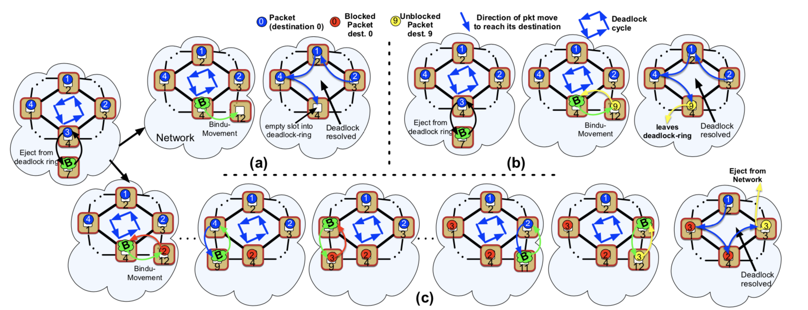
BINDU: Deadlock Freedom Proof

Slide 20
Outline
Background: Deadlocks
Current Solutions
BINDU
Concept
Definition
Walk-through
Deadlock freedom proof
Router microarch
Deep Dive
Evaluations
Methodology
Results
Conclusion

Slide 21
BINDU Router Microarchitecture
Bindu path is confined to VC-0 of each inport (except injection port) of all the routers in the Network

Slide 22
Outline
Background: Deadlocks
Current Solutions
BINDU
Concept
Definition
Walk-through
Deadlock freedom proof
Router microarch
Evaluations
Methodology
Results
Conclusion

Slide 23
Evaluations
Used gem5 and Garnet2.0 for network simulation
In BINDU packet uses fully random minimal routing and hence enjoys full path diversity
BINDU is evaluated on regular and irregular topologies
BINDU is evaluated for both real application and synthetic traffic pattern

Slide 24
Outline
Background: Deadlocks
Current Solutions
BINDU
Concept
Definition
Walk-through
Deadlock freedom proof
Router microarch
Deep Dive
Evaluations
Methodology
Results
Conclusion

Slide 25
Results: Synthetic traffic, regular topology
Uniform random
Transpose
45% higher throughput over Escape VC
30% higher throughput over BBR
Similar throughput as SPIN without complexities
Shuffle
Fault-0

Slide 26
Results: Synthetic traffic, irregular topology
Uniform random
Transpose
40% higher throughput over Escape VC
25% higher throughput over Escape VC
10% higher throughput over SPIN
Shuffle
Fault-12

Slide 27
Results: MOESI Cache Coherence
Fault-0
Fault-8
out-performs prior deadlock freedom solutions
Higher benefits observed in more fragmented topologies

Slide 28
Results: MOESI Cache Coherence
Fault-0
Fault-8
7% average reduction in runtime of real applications

Slide 29
Results: Bindu Sweep
Low-load latency increases with number of Bindus
Low-load latency increases with number of faults
Saturation throughput decreases with number of Bindus
Saturation throughput decreases with number of faults
Effect of Bindu is more pronounced for lower vc-per-input port

Slide 30
Results: Sensitivity study
Saturation throughput decreases with increase in Bindu Movement Period
BINDU has lower link traversal overhead

Slide 31
Outline
Background: Deadlocks
Current Solutions
BINDU
Concept
Definition
Walk-through
Deadlock freedom proof
Router microarch
Deep Dive
Evaluations
Methodology
Results
Conclusion

Slide 32
Revisiting Qualitative Comparison
Solution Proposed | Full Path Diversity | High Throughput | No Extra VCs | No Deadlock Detection | Topology agnostic
Dally’s Theory
Duato’s Theory
Flow Control
Recovery
Deflection
BBR
BINDU
*
*in all VCs except escape VC

Slide 33
Conclusion
Questions?
Deadlock is the problem which every network has to deal with
Current solutions either add turn restrictions (sacrificing path diversity), or require additional VCs, or require expensive circuitry to detect and recover from deadlocks
BINDU provides a novel way of resolving deadlock by providing one guaranteed empty VC in whole network that cycles through the network
BINDU provides performance benefits over both deadlock avoidance and deadlock recovery schemes at a low area/power overhead
BINDU enjoys full path-diversity, requires no additional VCs and is completely topology agnostic
BINDU
Thank you!

Slide 34
Mayank Parasar
Thank you!
mparasar3@gatech.edu

